Slide 1

Evaluating a RAG chat app
Pamela Fox, Python Cloud Advocate
www.pamelafox.org
@pamelafox

Slide 2




RAG: Retrieval Augmented Generation
Yes, your company perks cover underwater activities such as scuba diving lessons ¹
Do my company perks cover underwater activities?
PerksPlus.pdf#page=2: Some of the lessons covered under PerksPlus include: · Skiing and snowboarding lessons · Scuba diving lessons · Surfing lessons · Horseback riding lessons These lessons provide employees with the opportunity to try new things, challenge themselves, and improve their physical skills.….
User
Question
Document Search
Large Language Model

Slide 3
Are the answers high quality?
Are they correct? (relative to the knowledge base)
Are they clear and understandable?
Are they formatted in the desired manner?
Yes, according to the information provided in the PerksPlus.pdf document, underwater activities such as scuba diving are covered under the program.
Do the perks cover underwater activities?
Yes, the perks provided by the PerksPlus Health and Wellness Reimbursement Program cover a wide range of fitness activities, including underwater activities such as scuba diving. The program aims to support employees' physical health and overall well-being, so it includes various lessons and experiences that promote health and wellness. Scuba diving lessons are specifically mentioned as one of the activities covered under PerksPlus. Therefore, if an employee wishes to pursue scuba diving as a fitness-related activity, they can expense it through the PerksPlus program.
Yes, underwater activities are included as part of the PerksPlus program. Some of the underwater activities covered under PerksPlus include scuba diving lessons [PerksPlus.pdf#page=3].

Slide 4
What affects the quality?
Question
Document Search
Large Language Model
Search engine (ie. Azure AI Search)
Search query cleaning
Search options (hybrid, vector, reranker)
Additional search options
Data chunk size and overlap
Number of results returned
System prompt
Language
Message history
Model (ie. GPT 3.5)
Temperature (0-1)
Max tokens

Slide 5

Manual
experimentation
Notes:
And gaining intuition

Slide 6
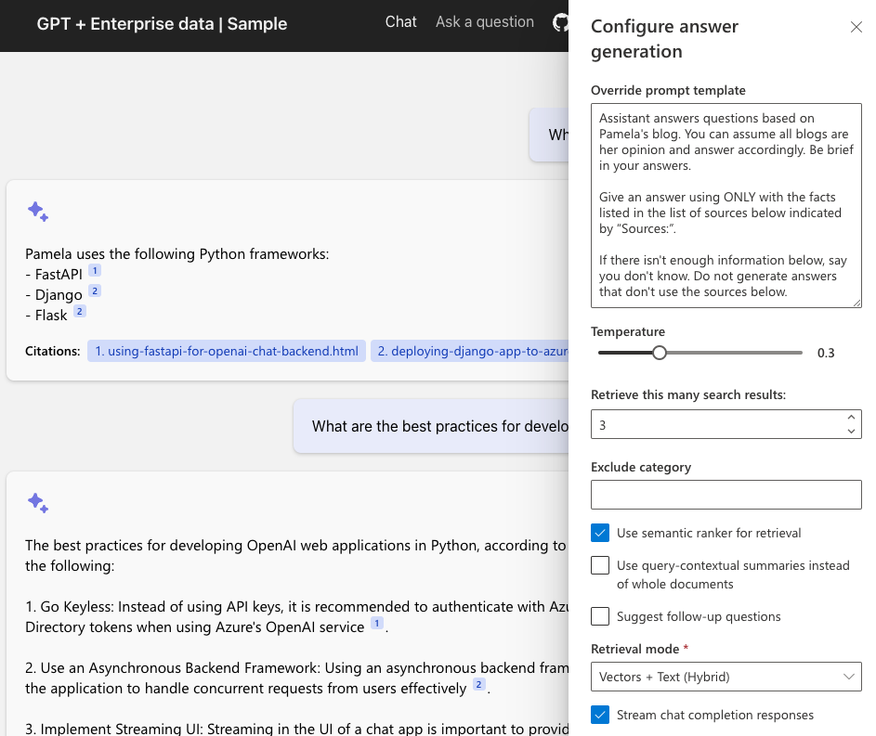
Experimenting with quality factors
aka.ms/ragchat
“Developer Settings” →

Slide 7
Automated
evaluation
Notes:
And gaining intuition

Slide 8
Evaluate with promptflow-evals
pip install promptflow-evals
from promptflow.evals.evaluators import RelevanceEvaluator
relevance_eval = RelevanceEvaluator(model_config)
relevance_score = relevance_eval(
question=user_question,
answer=answer,
context=sources,
)
https://learn.microsoft.com/azure/ai-studio/how-to/develop/flow-evaluate-sdk

Slide 9
Built-in evaluators
SimilarityEvaluator
F1ScoreEvaluator
GroundednessEvaluator
Question | Context | Answer | Ground truth
RelevanceEvaluator
CoherenceEvaluator
FluencyEvaluator
https://learn.microsoft.com/azure/ai-studio/how-to/develop/flow-evaluate-sdk

Slide 10
Bulk evaluation
To run same evaluators on many QA pairs, you can use evaluate():
from promptflow.evals.evaluate import evaluate
result = evaluate(
data="data.jsonl",
evaluators={
"relevance": relevance_eval,
"groundedness": groundedness_eval
},
azure_ai_project = azure_ai_project,
output_path="./myevalresults.json"
)
https://learn.microsoft.com/azure/ai-studio/how-to/develop/flow-evaluate-sdk

Slide 11
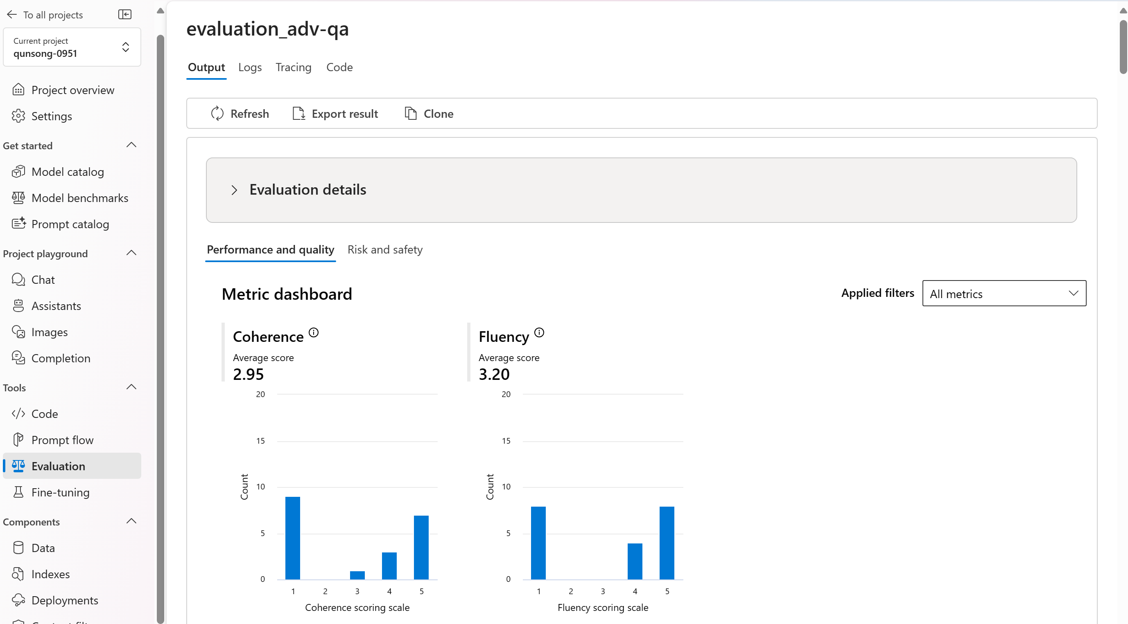
View results in Azure AI Studio
If you specified an azure_ai_project, you can view results in the studio:
https://learn.microsoft.com/azure/ai-studio/how-to/evaluate-flow-results

Slide 12
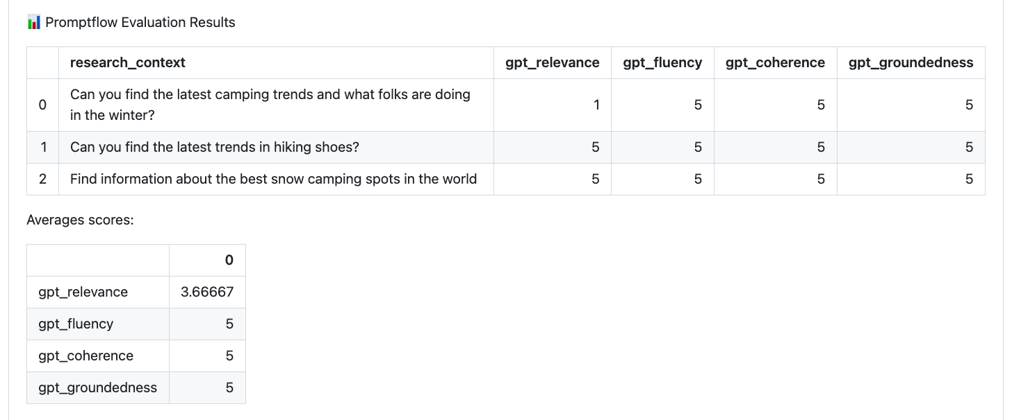
View results in GitHub Actions
You could also save results locally and display in GitHub actions:
https://github.com/Azure-Samples/contoso-creative-writer/blob/main/src/api/evaluate/evaluate.py
https://github.com/Azure-Samples/contoso-creative-writer/actions/runs/10724620439

Slide 13
RAG chat
evaluator CLI
Notes:
And gaining intuition

Slide 14
RAG chat evaluator
CLI tools for automating the evaluation of RAG answer quality:
Generate ground truth data
Evaluate with different parameters
Compare the metrics and answers across evaluations
https://github.com/Azure-Samples/ai-rag-chat-evaluator
aka.ms/rag/eval
Based on the promptflow-evals SDK:
https://pypi.org/project/promptflow-evals/

Slide 15



Ground truth data
The ground truth data is the ideal answer for a question.
Manual curation is recommended!
Generate Q/A pairs from a search index:
python3 -m scripts generate --output=example_input/qa.jsonl
--numquestions=200 --persource=5
documents
prompt + docs
Q/A pairs
Azure
AI Search
azure-ai-generative
SDK
Azure OpenAI

Slide 16

Evaluation
Compute GPT metrics and custom metrics for every question in ground truth.
Evaluate based off the configuration:
python3 -m scripts evaluate -–config=example_config.json
gpt_coherence
response
+ ground truth
gpt_groundedness
question
prompt
metrics
gpt_relevance
length
Local endpoint
azure-ai-generative
SDK
Azure OpenAI
has_citation

Slide 17
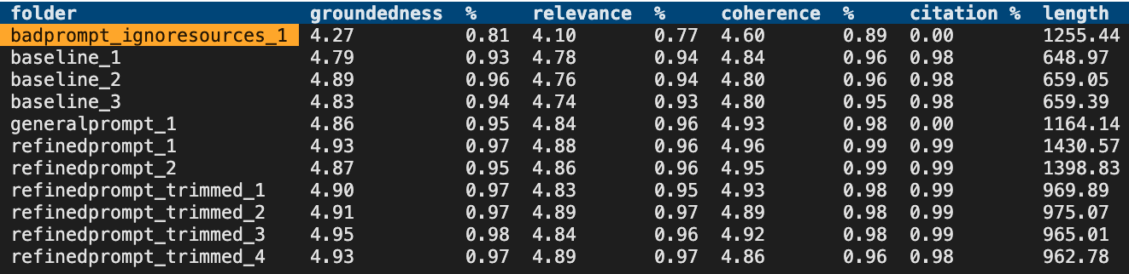
Review the metrics across runs
After you’ve run some evaluations, review the results:
python3 -m review_tools summary example_results

Slide 18
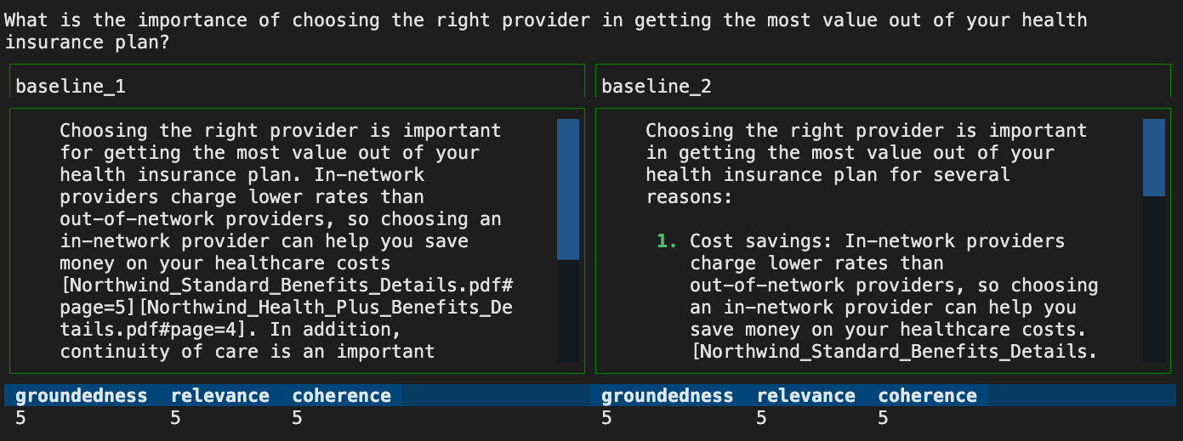
Compare answers across runs
python3 -m review_tools diff example_results/baseline_1
example_results/baseline_2

Slide 19
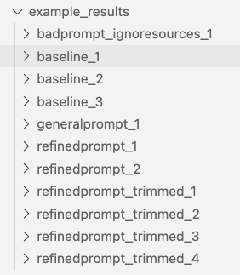
Evaluation approach
Evaluate at least 200 Q/A pairs.
Start by evaluating the baseline, the default parameters.
For each set of parameters, evaluate at least 3x
And/or use seed in the app itself to reduce variation.
Track evaluation results in a repo, tied to RAG code changes.

Slide 20
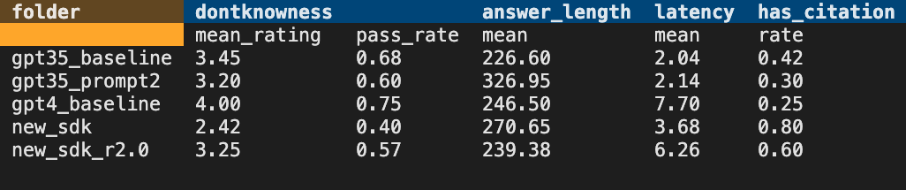
Can your RAG admit it doesn't know?
Generate questions that shouldn't be answerable:
python -m scripts generate-dontknows --input=example_input/qa.jsonl
--output=example_input/qa_dontknows.jsonl --numquestions=45
Evaluate with dontknowness metric:
python -m scripts evaluate --config=dontknows.config.json
Review results:

Slide 21
Continuous
evaluation
Notes:
And gaining intuition

Slide 22
LLM Ops for LLM Apps
1. Ideating/exploring
2. Building/augmenting
3. Operationalizing
Identify business use case
Run app against sample questions
Run flow against larger dataset
Deploy app to users
Try different parameters
Evaluate answers
Add monitoring and alerts
Connect to your data
Change defaults
Evaluate user feedback
Customize prompt for domain
Improve the prompt and orchestration
Satisfied?
Yes
Satisfied?
Yes
No
No

Slide 23
Online evaluation
You can run evaluations on deployed applications on live answers, as long as your metric doesn't require ground truth.
Evaluation metric | Can run without ground truth?
FluencyEvaluator | ✅
CoherenceEvaluator | ✅
RelevanceEvaluator | ✅
GroundednessEvaluator | ✅
SimilarityEvaluator | ❌
F1ScoreEvaluator | ❌
has_citation | ✅
citation_match | ❌

Slide 24
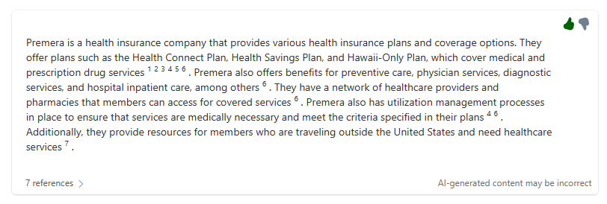
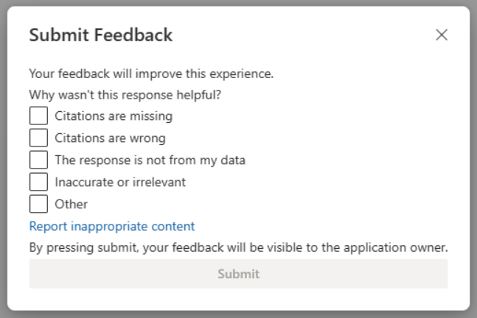
Improving ground truth data sets
Add a 👍🏼/👎🏼 button
with feedback dialog
to your live app:
Then you can:
Manually debug the answers that got rated 👎🏼
Add 👎🏼 questions to ground truth data
https://github.com/microsoft/sample-app-aoai-chatGPT/pull/396
aka.ms/rag/thumbs

Slide 25
Next steps
aka.ms/ragchat/free
Create an LLM/RAG app
Run the evaluator tools
Report any issues or suggest improvements 🪳 🙋🏽‍♂️ 🙋🏾‍♀️
Share your learnings about how you improved metrics 📝 📢
aka.ms/rag/eval

